Slide 1
Mobile Application Development

Slide 2
Introduction to JavaScript

Slide 3
Interpreted Language
Each browser has its own JavaScript engine, which either interprets the code, or uses some sort of lazy compilation
V8: Chrome and Node.js
SpiderMonkey: Firefox
JavaScriptCore: Safari
Chakra: Microsoft Edge/IE
They each implement the ECMAScript standard, but may differ for anything not defined by the standard

Slide 4
Syntax
Declarations
Var
Let
Const
Variables
Same as most other languages
Declaring variables
Global and local scope
Literals {}, [], ‘ ’, 1, 2

Slide 5
Datatypes
Dynamic typing
Primitive types
undefined
null
boolean
number
string
symbol
Objects

Slide 6
Typecasting? Coercion.
Explicit vs. Implicit Coercion
== vs ===

Slide 7
Primitives Vs. Objects
Primitives are immutable
Objects are mutable and stored by reference
Passing by reference vs. passing by value

Slide 8
Scoping
Lexical
Block

Slide 9
Array Functions
Filter
The filter() method creates a new array with all elements that pass the test implemented by the provided function
const words = ['spray', 'limit', 'elite', 'exuberant', 'destruction', 'present'];
const result = words.filter(word => word.length > 6);
Map
The map() method creates a new array populated with the results of calling a provided function on every element in the calling array.
const array1 = [1, 4, 9, 16
map1 = array1.map(x => x * 2);

Slide 10
Array Functions
Reduce
Arr.reduce( function, initial value)
Return a single

Slide 11
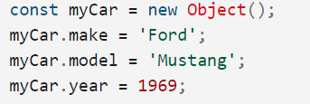
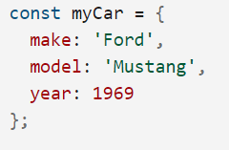
Objects
An object is a collection of properties, and a property is an association between a name (or key) and a value.
Creation

Slide 12
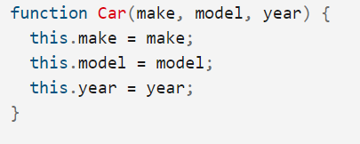

Objects
Constructor
Define the object type by writing a constructor function. use a capital initial letter(convention).
Create an instance of the object with new.

Slide 13
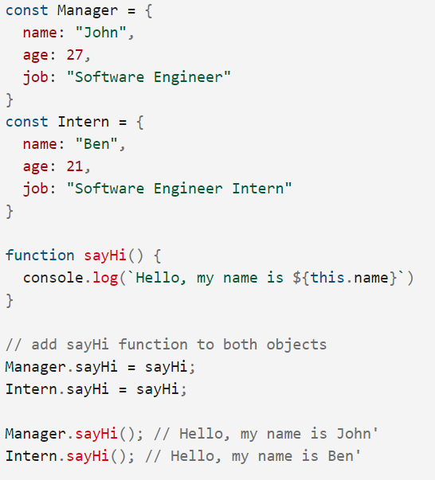
Objects
Use of this
use within a method to refer to the current object.

Slide 14
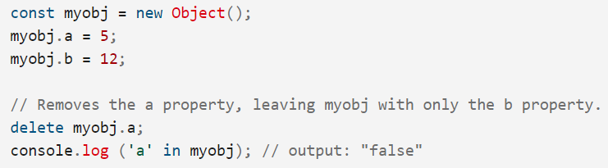
Objects
Deleting properties
can remove a non-inherited property

Slide 15
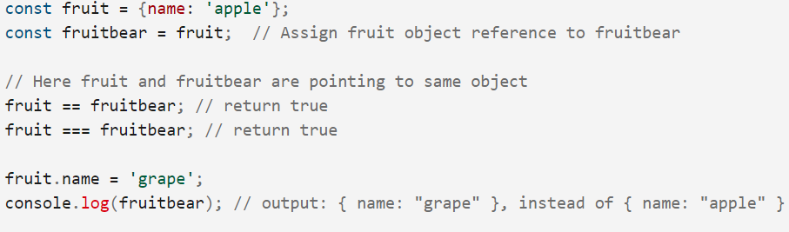
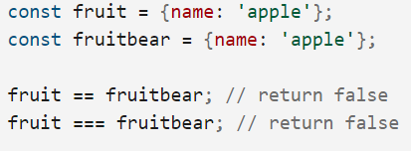
Objects
Comparing objects
objects are a reference type.
distinct objects are never equal, even if they have the same properties.
Only comparing the same object reference with itself yields true.

Slide 16
References
https://www.w3schools.com/js/default.asp
https://developer.mozilla.org/en-US/docs/Web/JavaScript

